Slide 1

Cs 429:DATA MINING Lecture 14
Instructor:
Osama Ahmed Khan
osamaahmedkhan
Jul 18th, 2017

Slide 2
Algorithms
Inferring Rudimentary Rules
Statistical Modeling
Divide-and-Conquer: Constructing Decision Trees
Covering Algorithms: Constructing Rules
Mining Association Rules
Linear Models
Instance-Based Learning
Clustering

Slide 3
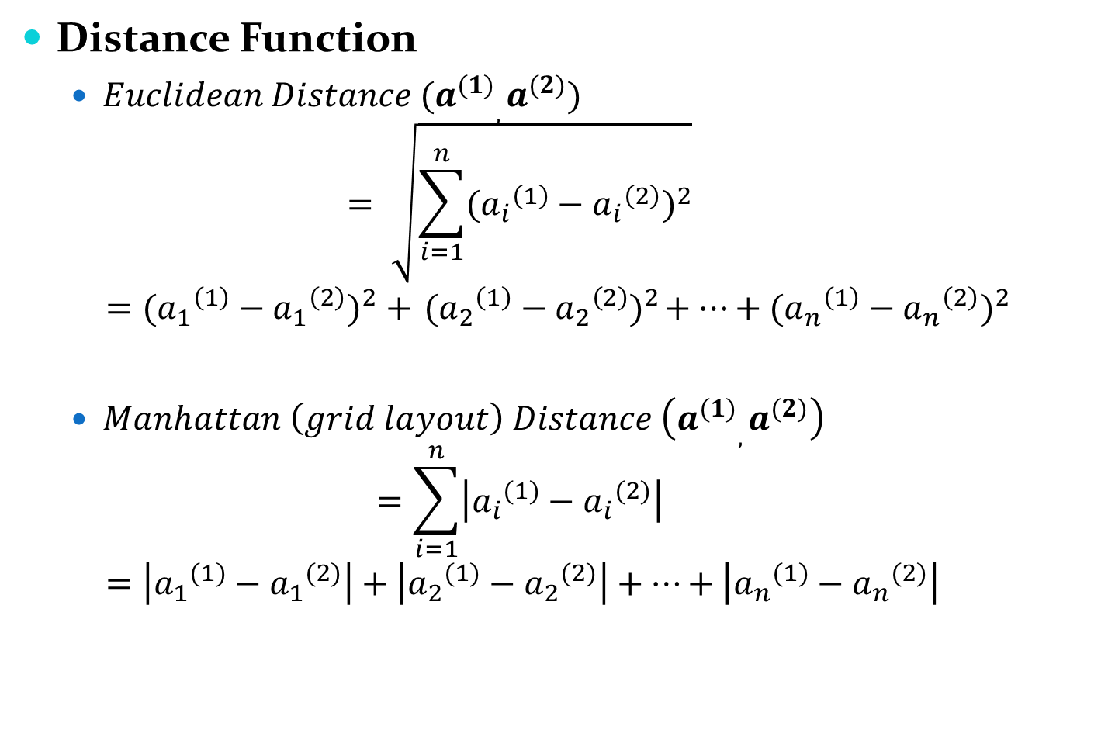
Instance-Based Learning
Distance Function
$Euclidean Distance (a_{}^{(1)},a_{}^{(2)})$
$$= \sqrt{\sum_{i=1}^{n}{{({a_{i}}_{}^{\left(1\right)}−{a_{i}}_{}^{\left(2\right)})}^{2}}}$$
$$={({a_{1}}_{}^{\left(1\right)}−{a_{1}}_{}^{\left(2\right)})}^{2} +{ ({a_{2}}_{}^{\left(1\right)}−{a_{2}}_{}^{\left(2\right)})}^{2}+…+{({a_{n}}_{}^{\left(1\right)}−{a_{n}}_{}^{\left(2\right)})}^{2}$$
$Manhattan \left(grid layout\right) Distance \left(a_{}^{(1)},a_{}^{(2)}\right)$
$$=\sum_{i=1}^{n}{\left|{a_{i}}_{}^{(1)}−{a_{i}}_{}^{(2)}\right|}$$
$$=\left|{a_{1}}_{}^{(1)}−{a_{1}}_{}^{(2)}\right|+\left|{a_{2}}_{}^{(1)}−{a_{2}}_{}^{(2)}\right|+…+\left|{a_{n}}_{}^{(1)}−{a_{n}}_{}^{(2)}\right|$$

Slide 4

Instance-Based Learning
Distance Function
$Higher power Distances (Cubic, Quadratic, etc.)$
Increases influence of large differences at the expense of small differences

Slide 5

Instance-Based Learning
Attribute Normalization
Categorical Attributes
Binary Distance (0,1)
No Scaling required
Missing Values
Categorical Attributes: Distance = 1
Numerical Attributes: Distance = max(1- a_{i}, a_{i})

Slide 6
Instance-Based Learning
Nearest-Neighbor Classification
k-Nearest-Neighbor Classification

Slide 7
Algorithms
Inferring Rudimentary Rules
Statistical Modeling
Divide-and-Conquer: Constructing Decision Trees
Covering Algorithms: Constructing Rules
Mining Association Rules
Linear Models
Instance-Based Learning
Clustering

Slide 8
Clustering
No Classes, only Groups
k-means Clustering
k: Number of Clusters desired
Select k points randomly as Cluster Centers
Calculate Euclidean Distance between each training instance and k points
Assign training instances to closest Clusters
Calculate Means/Centroids of each Cluster
Assign Means/Centroids to be the new Cluster Centers
Repeat Steps 2 - 6 until Cluster Centers remain unchanged

